Slide 1
NIDDK (National Institute of Diabetes and Digestive and Kidney Diseases
Simplilearn - Data Science Capstone Project
June 2022

Slide 2
Create a dashboard in tableau by choosing appropriate chart types and metrics useful for the business. The dashboard must entail the following:
Pie chart to describe the diabetic or non-diabetic population
Scatter charts between relevant variables to analyze the relationships
Histogram or frequency charts to analyze the distribution of the data
Heatmap of correlation analysis among the relevant variables
Create bins of these age values: 20-25, 25-30, 30-35, etc.
Analyze different variables for these age brackets using a bubble chart.
Project Task:
Data Reporting:

Slide 3
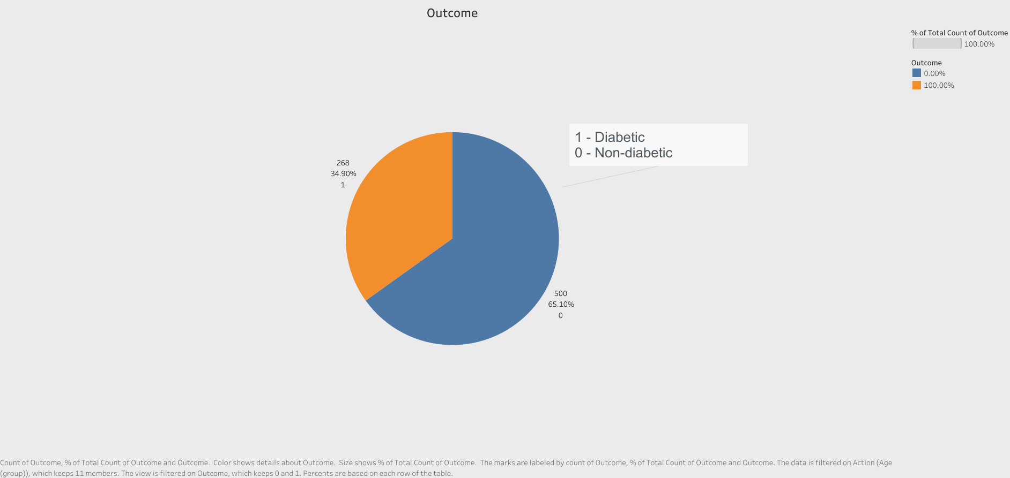

Slide 4
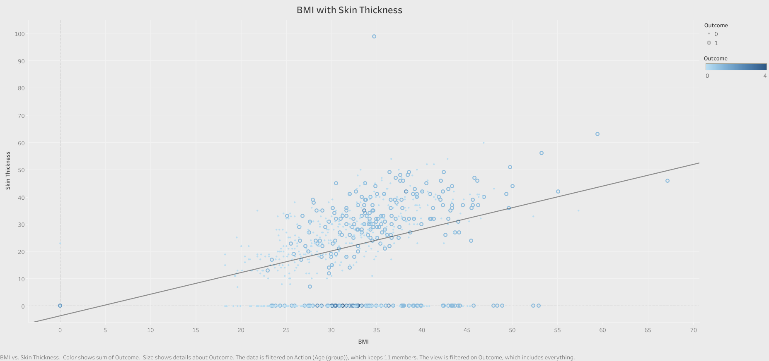

Slide 5
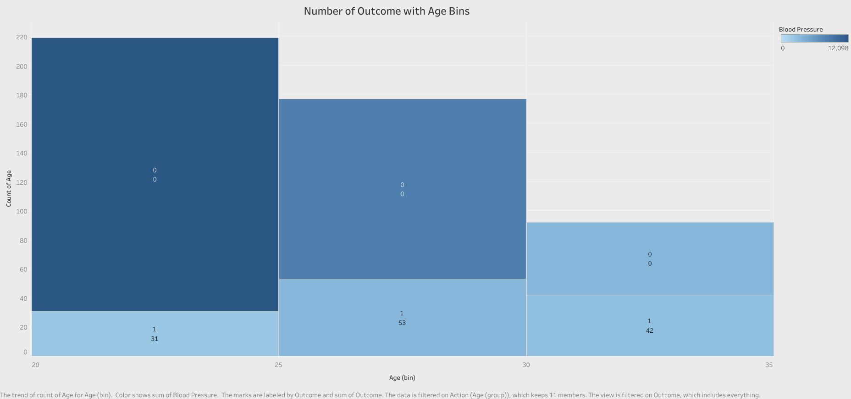

Slide 6
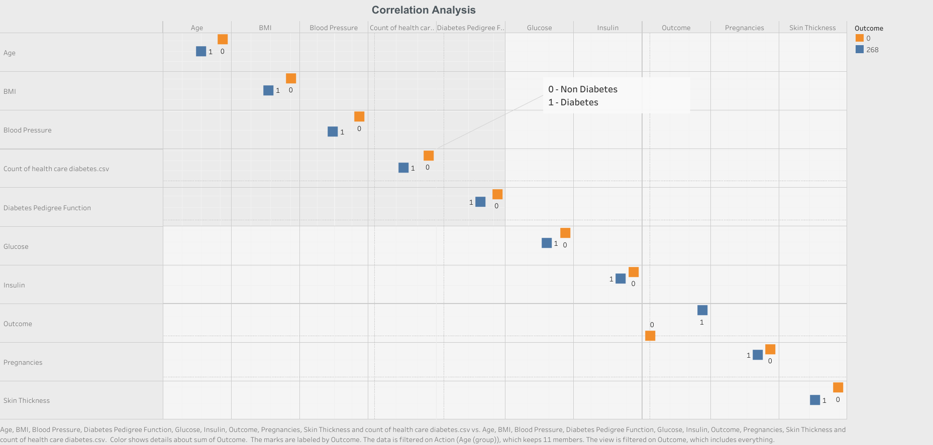

Slide 7
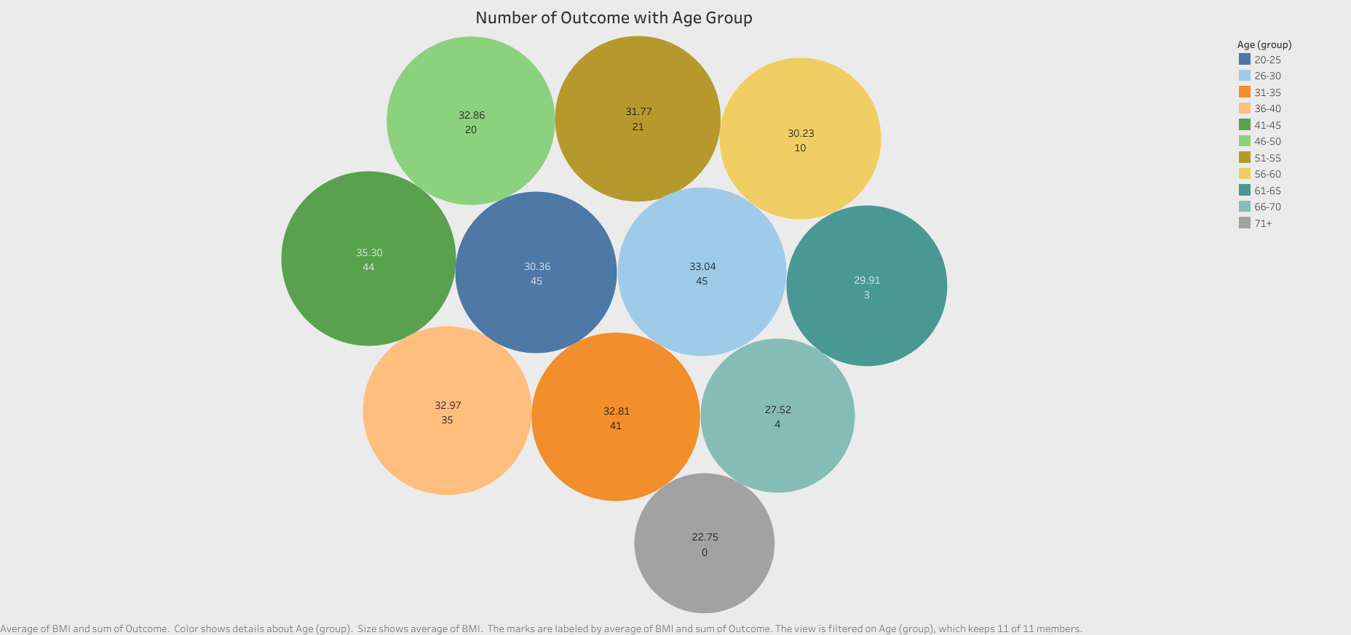

Slide 8
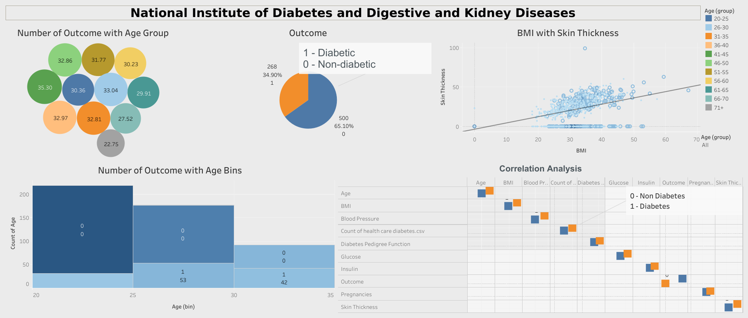

Slide 9
Thank You.

